Slide 1
UPPER SIXTH ARTS
GEOGRAPHY
Lesson 7: Population Pyramids
Population Pyramids
Notes:
Good morning, class, and welcome to our geography lesson. I am your geography teacher, Mr Kamdem. Today we are starting Lesson 7: Population Pyramids.

Slide 2
CLASS INFO
Class, Chapter and Duration
Class | Upper Sixth Arts
Chapter | Module 4: Understanding and managing population dynamics across the world in general and Cameroon in particular
Duration | 2 periods (2 × 50 minutes)
Notes:
This lesson is for Upper Sixth Arts. It belongs to Module 4: Understanding and managing population dynamics across the world in general and Cameroon in particular. We shall need 2 periods to cover it.

Slide 3
IDENTIFICATION
Lesson Identification
Topic | Population Structure and Composition
Sub-topic | Age-Sex Pyramids
Lesson | Lesson 7: Population Pyramids
Notions / Concepts | Age-sex pyramid, expansive, stationary, constrictive, dependency ratio.
Syllabus focus | Meaning and types of pyramids; differences between regions; demographic and non-demographic factors; dependency ratio.
Competence | Learners are able to read population pyramids and explain their shapes.
Notes:
Our topic is Population Structure and Composition, and the sub-topic is Age-Sex Pyramids. The key notions we shall use today are: age-sex pyramid, expansive, stationary, constrictive, dependency ratio. At the end, you should be able to do this: learners are able to read population pyramids and explain their shapes.

Slide 4

HOMEWORK CORRECTION
Correction of the Homework
Question (Lesson 6: Age and Sex Composition):
List three needs of young people and three needs of old people in your town.
Notes:
Before we start the new lesson, let us correct the homework I gave you at the end of Lesson 6: Age and Sex Composition. The question was: List three needs of young people and three needs of old people in your town. Take out your exercise books.

Slide 5
HOMEWORK CORRECTION
Correction: Possible Answer
Young people need schools, jobs and leisure facilities; old people need health care, pensions and care homes or family support.
Notes:
Here is a good answer. Young people need schools, jobs and leisure facilities; old people need health care, pensions and care homes or family support. Compare it with your own answer and correct your work in red.

Slide 6
LESSON PLAN
Lesson Plan
Correction of the homework
Objectives and recall
Real-life situation and action to take
Learning activities
Board summary
Evaluation, remediation and homework
Notes:
Here is the plan of our lesson today. First, we shall correct the homework. Then we shall look at the objectives and recall what you already know. After that, we shall study a situation from real life and the action to take, and do the learning activities. Finally, we shall copy the board summary, do the evaluation and the remediation, and I will give you the homework.

Slide 7
OBJECTIVES
Objectives
By the end of this lesson, you should be able to:
Define and describe a population pyramid.
Identify expansive, stationary and constrictive pyramids.
Notes:
Take your time to copy this part; we will continue together.

Slide 8
OBJECTIVES
Objectives (continued)
Explain factors of pyramid shape and calculate the dependency ratio.
Notes:
By the end of this lesson, you should be able to do three things. Number 1: define and describe a population pyramid. Number 2: identify expansive, stationary and constrictive pyramids. Number 3: explain factors of pyramid shape and calculate the dependency ratio.

Slide 9
PREVIOUS KNOWLEDGE
Previous Knowledge
Youthful populations have many children.
Ageing populations have many old people.
Notes:
Let us first remember what you already know. Youthful populations have many children. Ageing populations have many old people. Keep this in mind, because we shall build on it today.

Slide 10
REAL-LIFE SITUATION
Situation in Real Life
A teacher shows two graphs shaped like a pointed triangle and a pot with a narrow base. She says, "One is Cameroon, the other is Japan. Which is which, and why?"
Notes:
Listen carefully to this situation from real life. A teacher shows two graphs shaped like a pointed triangle and a pot with a narrow base. She says, "One is Cameroon, the other is Japan. Which is which, and why?" Think about it, because I am going to ask you some questions.

Slide 11
REAL-LIFE SITUATION
Situation: Question 1
What is the problem in the situation?
Notes:
Question 1: What is the problem in the situation? Think for a moment, then raise your hand to answer.

Slide 12
REAL-LIFE SITUATION
Answer
Learners must identify countries from their pyramids.
Notes:
Good. Learners must identify countries from their pyramids.

Slide 13
REAL-LIFE SITUATION
Situation: Question 2
Which shape is Cameroon?
Notes:
Question 2: Which shape is Cameroon? Think for a moment, then raise your hand to answer.

Slide 14
REAL-LIFE SITUATION
Answer
The pointed triangle (wide base).
Notes:
Good. The pointed triangle (wide base).

Slide 15
REAL-LIFE SITUATION
Situation: Question 3
What makes the base wide?
Notes:
Question 3: What makes the base wide? Think for a moment, then raise your hand to answer.

Slide 16
REAL-LIFE SITUATION
Possible Answer
Many births.
Notes:
Good. Many births.

Slide 17
ACTION TO TAKE
Action to Take
Read population pyramids to plan for the future.
Notes:
From this situation, the action we are working towards in this lesson is the following: read population pyramids to plan for the future.

Slide 18
JUSTIFICATION
Justification of the Lesson
This lesson helps us to read pyramids and understand what they tell us about a country.
Notes:
Why is this lesson important for you? This lesson helps us to read pyramids and understand what they tell us about a country.

Slide 19

1. MEANING
Activity 1
Population pyramid of Cameroon (approximate).
Notes:
Activity 1. Look carefully at this diagram: population pyramid of Cameroon (approximate). Observe every detail before I ask the question.

Slide 20
1. MEANING
Activity 1: Question
What does the wide base show?
Notes:
Here is the question for Activity 1: What does the wide base show? Take one minute to think and write your answer in your rough notebook.

Slide 21
1. MEANING
Activity 1: Answer
A high birth rate and many children.
Notes:
Let us check the answer together. A high birth rate and many children.

Slide 22
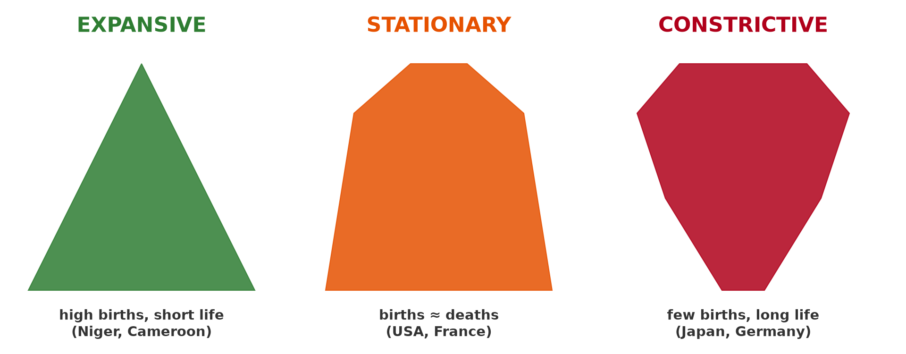
2. TYPES OF PYRAMIDS
Activity 2
Three types of pyramid.
Notes:
Activity 2. Look carefully at this diagram: three types of pyramid. Observe every detail before I ask the question.

Slide 23
2. TYPES OF PYRAMIDS
Activity 2: Question
Which type has a narrow base and wide top?
Notes:
Here is the question for Activity 2: Which type has a narrow base and wide top? Take one minute to think and write your answer in your rough notebook.

Slide 24
2. TYPES OF PYRAMIDS
Activity 2: Answer
Constrictive.
Notes:
Let us check the answer together. Constrictive.

Slide 25

2. TYPES OF PYRAMIDS
Activity 3
Population pyramid of Japan (approximate).
Notes:
Activity 3. Look carefully at this diagram: population pyramid of Japan (approximate). Observe every detail before I ask the question.

Slide 26
2. TYPES OF PYRAMIDS
Activity 3: Question
Why is the top of Japan's pyramid so wide for women?
Notes:
Here is the question for Activity 3: Why is the top of Japan's pyramid so wide for women? Take one minute to think and write your answer in your rough notebook.

Slide 27
2. TYPES OF PYRAMIDS
Activity 3: Answer
Women live longer than men and life expectancy is very high.
Notes:
Let us check the answer together. Women live longer than men and life expectancy is very high.

Slide 28

3. FACTORS
Activity 4
A baby being vaccinated.
Notes:
Activity 4. Look carefully at this picture: a baby being vaccinated. Observe every detail before I ask the question.

Slide 29
3. FACTORS
Activity 4: Question
How do vaccines change the shape of a pyramid?
Notes:
Here is the question for Activity 4: How do vaccines change the shape of a pyramid? Take one minute to think and write your answer in your rough notebook.

Slide 30
3. FACTORS
Activity 4: Answer
Fewer children die, so the lower bars stay wide and people live longer.
Notes:
Let us check the answer together. Fewer children die, so the lower bars stay wide and people live longer.

Slide 31
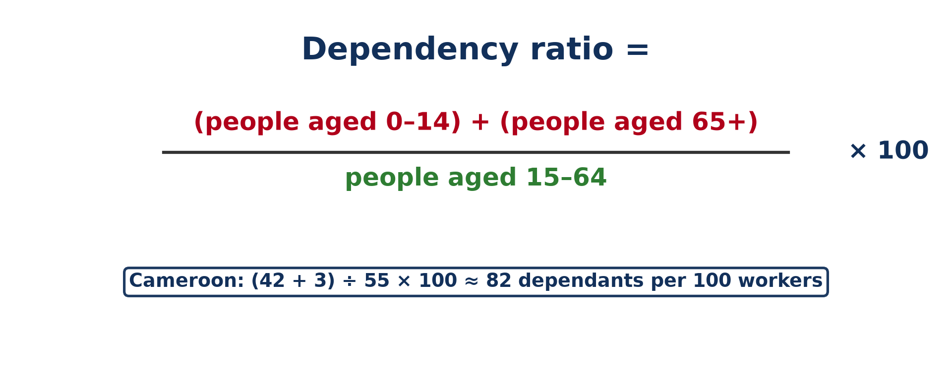
4. DEPENDENCY RATIO
Activity 5
The dependency ratio.
Notes:
Activity 5. Look carefully at this diagram: the dependency ratio. Observe every detail before I ask the question.

Slide 32
4. DEPENDENCY RATIO
Activity 5: Question
What does a dependency ratio of 82 mean?
Notes:
Here is the question for Activity 5: What does a dependency ratio of 82 mean? Take one minute to think and write your answer in your rough notebook.

Slide 33
4. DEPENDENCY RATIO
Activity 5: Answer
Every 100 people of working age support 82 dependants.
Notes:
Let us check the answer together. Every 100 people of working age support 82 dependants.

Slide 34
BOARD SUMMARY
Board Summary
Topic: Population Structure and Composition
Sub-topic: Age-Sex Pyramids
Lesson 7: Population Pyramids
Notes:
Now we are going to copy the board summary. Write the title and the headings neatly in your notebooks. I will give you enough time for each slide, so do not rush.

Slide 35
BOARD SUMMARY
1. Meaning of the Age-Sex Pyramid
The pyramid can be understood as follows:
Population pyramid: It is a bar graph that shows the percentage of males and females in each age group of a population. Males are on the left and females on the right.
Notes:
Let us copy Meaning of the Age-Sex Pyramid. The pyramid can be understood as follows. On this slide we have Population pyramid. Write each point on a new line, with the key term first, and explain it in your own words when we revise.

Slide 36
BOARD SUMMARY
1. Meaning of the Age-Sex Pyramid
Illustration: population pyramid of Cameroon
Notes:
Now draw this illustration in your notebook: population pyramid of Cameroon. Give it a title and label it clearly.

Slide 37
BOARD SUMMARY
2. Types of Pyramids
The main types of pyramids are:
Expansive (progressive) pyramid: It has a wide base and a narrow top, showing high birth and death rates. It is typical of LEDCs such as Cameroon.
Notes:
Let us copy Types of Pyramids. The main types of pyramids are. On this slide we have Expansive (progressive) pyramid. Write each point on a new line, with the key term first, and explain it in your own words when we revise. When you finish, we go to the next slide.

Slide 38
BOARD SUMMARY
2. Types of Pyramids (continued)
Stationary pyramid: It has almost straight sides, showing low birth and death rates. It is found in some MEDCs.
Constrictive (regressive) pyramid: It has a narrow base and a wide top, showing an ageing, declining population. Japan and Italy are examples.
Notes:
We continue with Types of Pyramids. On this slide we have Stationary pyramid and Constrictive (regressive) pyramid. Write each point on a new line, with the key term first, and explain it in your own words when we revise.

Slide 39
BOARD SUMMARY
2. Types of Pyramids
Illustration: types of pyramids
Notes:
Now draw this illustration in your notebook: types of pyramids. Give it a title and label it clearly.

Slide 40
BOARD SUMMARY
3. Factors and Indices
The shape of pyramids depends on:
Demographic factors: Birth rate shapes the base, death rate and life expectancy shape the top, and migration adds or removes groups. Wars and epidemics create notches.
Notes:
Let us copy Factors and Indices. The shape of pyramids depends on. On this slide we have Demographic factors. Write each point on a new line, with the key term first, and explain it in your own words when we revise. When you finish, we go to the next slide.

Slide 41
BOARD SUMMARY
3. Factors and Indices (continued)
Non-demographic factors: Education of women, family planning, health care and economic development change the shape in the long run. Policies such as China's one-child policy change it quickly.
Notes:
We continue with Factors and Indices. On this slide we have Non-demographic factors. Write each point on a new line, with the key term first, and explain it in your own words when we revise. When you finish, we go to the next slide.

Slide 42
BOARD SUMMARY
3. Factors and Indices (continued)
Dependency ratio: It is (people aged 0–14 + people over 65) ÷ people aged 15–64 × 100. A ratio of 82 means 82 dependants for every 100 workers.
Notes:
We continue with Factors and Indices. On this slide we have Dependency ratio. Write each point on a new line, with the key term first, and explain it in your own words when we revise.

Slide 43
FORMATIVE EVALUATION
Evaluation 1
Describe an expansive pyramid and give an example.
Notes:
Now let us check what you have understood. Question 1: Describe an expansive pyramid and give an example. Answer in your exercise book.

Slide 44
FORMATIVE EVALUATION
Expected Answer
Wide base, narrow top; high births, short lives; Cameroon.
Notes:
The expected answer is: wide base, narrow top; high births, short lives; Cameroon. If you got it right, well done.

Slide 45
FORMATIVE EVALUATION
Evaluation 2
Calculate the dependency ratio: 40 % aged 0–14, 5 % aged 65+, 55 % aged 15–64.
Notes:
Now let us check what you have understood. Question 2: Calculate the dependency ratio: 40 % aged 0–14, 5 % aged 65+, 55 % aged 15–64. Answer in your exercise book.

Slide 46
FORMATIVE EVALUATION
Expected Answer
(40 + 5) ÷ 55 × 100 ≈ 82.
Notes:
The expected answer is: (40 + 5) ÷ 55 × 100 ≈ 82. If you got it right, well done.

Slide 47
REMEDIATION
Remediation
Fill in the blanks:
A pyramid with a wide base is ______.
Japan has a ______ pyramid.
Dependants are aged 0–14 and ______.
Notes:
For those who need more practice, fill in the blanks in your exercise book. The answers are: number 1, expansive; number 2, constrictive; number 3, 65 and over.

Slide 48
HOMEWORK
Homework
Sketch the pyramids of Cameroon and Japan and list three differences.
Notes:
For your homework: Sketch the pyramids of Cameroon and Japan and list three differences. We shall correct it at the beginning of our next lesson.

Slide 49
NEXT LESSON
Next Lesson
Our next lesson will be on:
Practical Work 3: Dependency Ratio and Population Pyramids
Notes:
Our next lesson will be on Practical Work 3: Dependency Ratio and Population Pyramids. Thank you for your attention, and see you next time.

Slide 50
BILINGUAL GAME
Bilingual Game (Jeu Bilingue)
English | Français
Pyramid | La pyramide des âges
Base | La base
Dependant | La personne à charge
Ratio | Le rapport
Male | Masculin
Female | Féminin
Notes:
Let us play the bilingual game. I say a word in English, and you give me the French word. Then we do the reverse.

Slide 51
LOGBOOK
Official Logbook (1/2)
Module / Topic | Population Structure and Composition
Lesson Title | Lesson 7: Population Pyramids
Expected Learning Outcomes | Define and describe a population pyramid. Identify expansive, stationary and constrictive pyramids. Explain factors of pyramid shape and calculate the dependency ratio.
Competence | Learners are able to read population pyramids and explain their shapes.
Notes:
I record this information in the official logbook of the class after the lesson.

Slide 52
LOGBOOK
Official Logbook (2/2)
Matter Taught | Meaning of the Age-Sex Pyramid; Types of Pyramids; Factors and Indices.
Evaluation | Formative evaluation and remediation exercise.
Homework | Sketch the pyramids of Cameroon and Japan and list three differences.
Enrolment / Present / Absent | ____ / ____ / ____
Achievement | To be completed after the lesson.
Notes:
I complete the second page of the logbook: the matter taught, the evaluation, the homework and the attendance.

Slide 53
TEACHER'S NOTE
Teacher's Note
Timing: Homework correction, plan, objectives 8 min | Recall, situation, action 10 min | 5 activities 30 min | Board summary (copying) 30 min | Evaluation, remediation 10 min | Homework, next lesson 5 min | Logbook 7 min
Without the projector (Activity 1): describe the bars.
Without the projector (Activity 2): draw the three shapes.
Without the projector (Activity 3): compare the two sides.
Without the projector (Activity 4): discuss child mortality.
Without the projector (Activity 5): do the calculation.
Notes:
This slide is for me, the teacher: it gives the timing of the lesson and what to do if the projector is not available.

Slide 54
REFERENCES
References
National Geography Syllabus, MINESEC/IGE/IP-SS, 2019 — Module 4 (Population Geography).
Photo, Activity 4: “Isatu gets a vaccination for her 5 week old son” by World Bank Photo Collection, CC BY-NC-ND 2.0, via Flickr (https://www.flickr.com/photos/10816734@N03/26372818523)
Diagrams and animations: drawn for this lesson (Geography Department).
Notes:
These are the references and picture credits used to prepare this lesson.

